Slide 1

Phishing Awareness Training
This presentation will equip you with the knowledge and tools to recognize and avoid phishing attacks, protecting you and your organization from cyber threats.
~Pranav Ghodke

Slide 2
What is Phishing?
A fraudulent attempt to steal sensitive information by disguising as a trustworthy entity.
Targets individuals, businesses, and organizations of all sizes.
Aimed at identity theft, financial gain, data breach, or malware distribution.

Slide 3
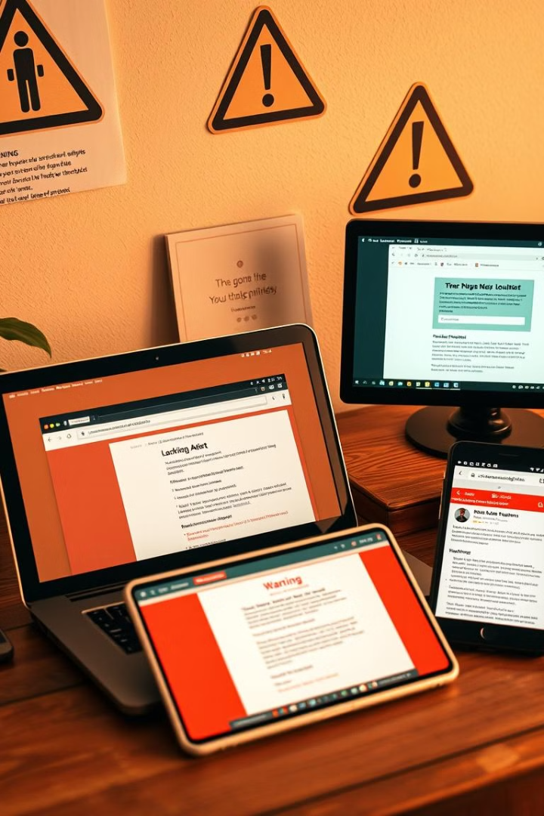
Common Phishing Attack Types
Email Phishing
Spear Phishing
Using deceptive emails like fake invoices, urgent requests, or shipping notifications.
Targeted at specific individuals or organizations, referencing internal projects or colleagues.
Whaling
Targeting high-profile executives with impersonation, wire transfer requests, or access to sensitive documents.

Slide 4
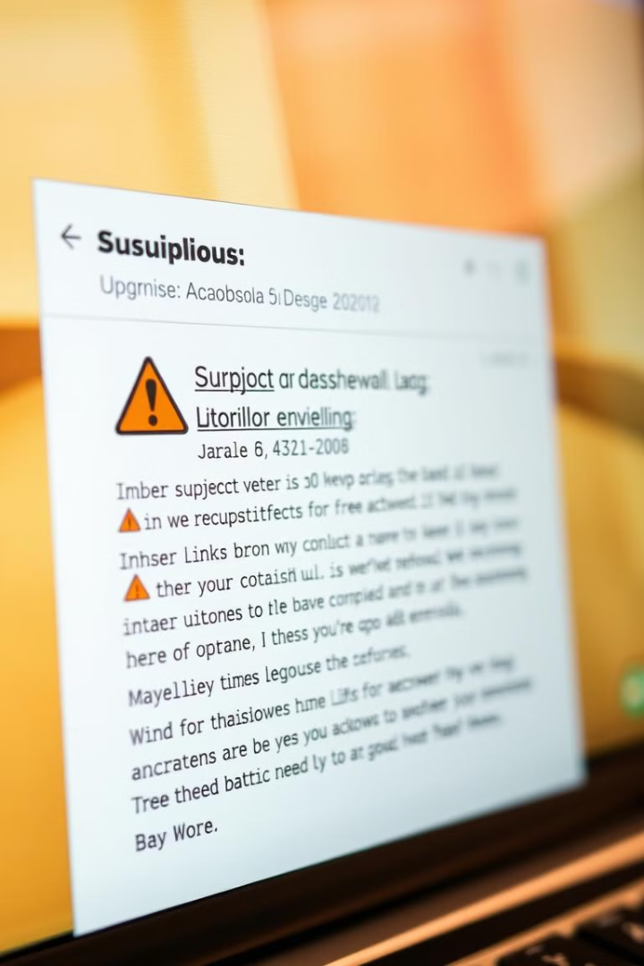
Recognizing Phishing Emails: Red Flags
1
Suspicious sender address: Misspellings, unusual domains, or public email services (e.g., @gmail.com for a corporate communication).
2
Generic greetings: "Dear Customer" instead of your name.
3
Grammatical errors & typos: Poor grammar, spelling mistakes, and awkward phrasing.
4
Sense of urgency: Demanding immediate action or threatening consequences.

Slide 5
Spotting Phishing Websites: Fake Login Pages
URL discrepancies: Look for subtle misspellings or variations in the domain name (e.g., "paypa1.com" instead of "paypal.com").
Lack of HTTPS: Check for the padlock icon in the address bar indicating a secure connection. Absence indicates lack of encryption and trust.
Poor design & layout: Amateurish design, broken images, outdated logos.

Slide 6
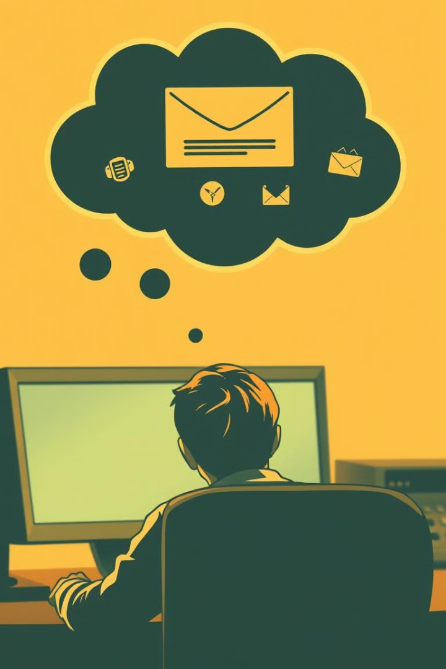



Social Engineering Tactics: Exploiting Human Psychology
Impersonating authority figures (e.g., CEO, IT admin, law enforcement).
Building rapport by posing as a friend, colleague, or trusted vendor.
Creating a sense of panic or threat to pressure victims into acting quickly.

Slide 7
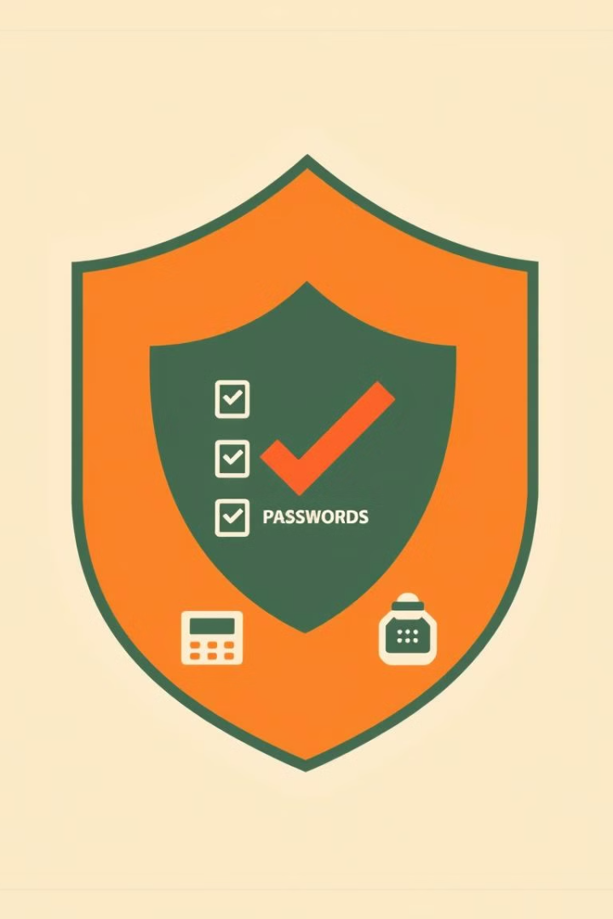




Best Practices: Protecting Yourself from Phishing
Think before you click: Always verify the sender's identity and the legitimacy of the request before clicking on any links or opening attachments.
Verify requests: If you receive a suspicious email or call, contact the sender through a known, trusted channel.
Enable multi-factor authentication (MFA): Adds an extra layer of security to your accounts.
Keep software updated: Regularly update your operating system, browser, and antivirus software to patch security vulnerabilities.

Slide 8

Conclusion: Stay Vigilant & Secure
Phishing is an evolving threat, requiring constant vigilance and awareness. By understanding the tactics used by phishers and following best practices, you can significantly reduce your risk of becoming a victim.

